Slide 1

DWS - Industry Integrated Skilling Program
Prepared by
Thousif

Slide 2
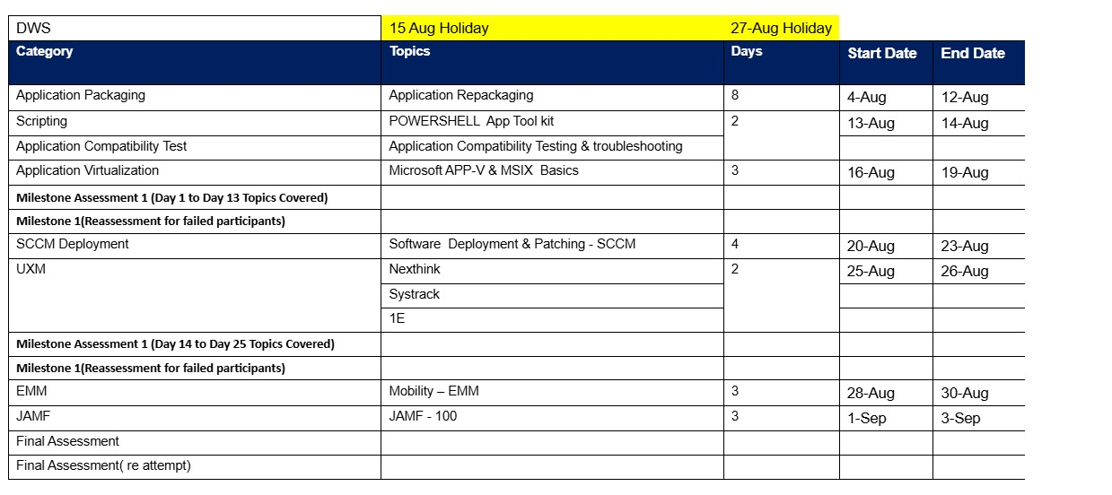
Program Dates

Slide 3
Program Schedule
8 hour per day
8:45 am – Session starts
15 mts Short break ( 11am – 11.15am)
60 mts Lunch break ( 1pm – 2.00pm)
15 mts Short break ( 4pm – 4.15pm)
5:15 pm Recap, Q&A, Feedback & Closing the day

Slide 4
Candidate guidelines
Be on-time
Ask questions if you have doubts or need clarification
Perform your Lab Activities without fail
Respect break times
Mobile phones in Silent mode
MCQ / Lab Assessment at the end of modules
Contact Trainer for any training or lab related issues

Slide 5
DWS Training

Slide 6
Training Module
Module 1 – Introduction to Windows Operating System

Slide 7
Introduction To Windows Operating System
Introduction to Operating System - An operating system (OS) is system software that manages computer hardware, software resources, and provides common services for computer programs.
Operating System Vendors –
Windows - Microsoft Windows – Wikipedia
Apple iOS
Android
Ubuntu
Linux

Slide 8
Introduction To Windows Operating System
Operating Systems Type
Client
Windows 10
Windows 11
2. Server
Windows Server 2016
Windows Server 2019
Windows Server 2022

Slide 9
Introduction To Windows Operating System
Operating Systems Version History
Client - Windows 10 - release information | Microsoft Learn
Server - Windows Server release information | Microsoft Learn

Slide 10
Introduction To Windows Operating System
Windows Operating System LifeCycle
  Supported versions of Windows client | Microsoft Learn
  Windows Server release information | Microsoft Learn

Slide 11
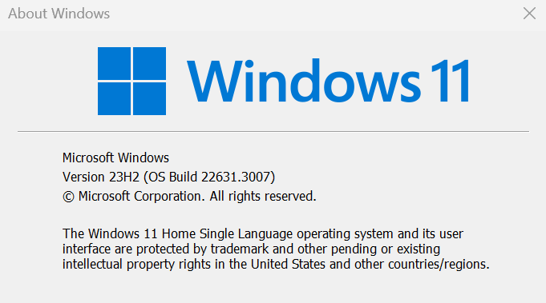
Introduction To Windows Operating System
Identifying Windows Build Version and Edition

Slide 12
Introduction To Windows Operating System
  Windows Basic Functions
  Start Menu
  Task Bar
  Command Prompt and PowerShell
  Universal App – Office
  File/Windows Explorer
  Inbuilt Apps – Edge
  MS Store

Slide 13
Introduction To Windows Operating System
  Windows Basic Functions
  Event viewer
  Windows Run
  UAC -Admin, Standard
  Windows Registry
  Disk Cleaner
  Disk Management
  Task Scheduler

Slide 14
Training Module
Module 2 – Application Packaging

Slide 15
Introduction To Application Packaging
Application Packaging - is the process of preparing software applications for deployment in a standardized, automated, and manageable way across multiple systems or environments. It’s especially crucial in enterprise IT environments where consistency, security, and scalability are key.
Their terms application packaging and repackaging is mostly used in the same sense. However, if we get the binaries from a vendor, then we combine them to make an application package. If we get a legacy installer from a vendor such as an exe or msi or batch files etc then we customize them as an application repackage.

Slide 16
Introduction To Application Packaging
Application packaging typically includes:
Customization: Tailoring the application settings to meet organizational needs (e.g., disabling auto-updates, setting default paths).
Bundling: Wrapping all necessary files, configurations, and dependencies into a single package.
Testing: Ensuring the package installs, runs, and uninstalls correctly without conflicts.
Deployment Readiness: Making the package compatible with deployment tools like SCCM, Intune, or other endpoint management systems.

Slide 17
Introduction To Application Packaging
Why Standard App Packaging is necessary in IT ?
Consistency: Ensures all users get the same version and configuration.
Efficiency: Speeds up deployment and reduces manual errors.
Security: Helps enforce policies and reduce vulnerabilities.
Scalability: Supports mass deployment across thousands of devices.

Slide 18
Device Driver Management
Device drivers are low-level software components that allow the operating system to communicate with hardware devices like printers, graphics cards, network adapters, etc.
They act as translators between the OS and the hardware.
Each device requires a specific driver to function properly.
Handling Drivers Within MSI Packages: MSI (Microsoft Installer) is a Windows installation package format used to install software, including drivers.
How Drivers Are Packaged in MSI:
MSI files can include drivers directly or call external driver installers.
Driver installation may be handled using:
DPInst.exe (Driver Package Installer)
PnPUtil.exe (Plug and Play Utility)

Slide 19
Device Driver Management
Driver-related files and where they go after installation:
After installation, drivers are staged in the DriverStore:
Location: C:\Windows\System32\DriverStore\FileRepository &
C:\Windows\inf
File Type | Description | Common Location
.inf | Driver setup info | Inside MSI or %SystemRoot%\INF
.sys | Driver binary | %SystemRoot%\System32\drivers
.cat | Catalog file for signing | %SystemRoot%\System32\CatRoot
.dll | Driver support libraries | %SystemRoot%\System32
.exe | Installer or helper tools | May be in MSI or %ProgramFiles%

Slide 20
Device Driver Management
Logs for Successful Installation
MSI Installation Logs: Enable logging with this command:
msiexec /i yourdriver.msi /L*v install.log
Event Viewer: Event Viewer → Windows Logs → System
Filter for source: DriverFrameworks-UserMode, Service Control Manager, or SetupAPI
Device Manager: Right-click device → Properties → Driver tab
Check driver version and provider
PnPUtil: pnputil /enum-drivers

Slide 21
Device Driver Management
Kernel Drivers? - Kernel drivers operate in Ring 0, the most privileged level of the operating system. They directly interact with hardware and core OS functions.
Examples of Kernel Drivers:
File system drivers (e.g., ntfs.sys)
Network drivers (e.g., ndis.sys)
Storage drivers (e.g., storport.sys)
Security drivers (e.g., antivirus kernel hooks)

Slide 22
Device Driver Management
Identifying Kernel Drivers
Windows Device Manager: View driver details under device properties → Driver tab → Driver File Details
Kernel drivers typically reside in C:\Windows\System32\drivers
DriverQuery Command: driverquery /v /fo list

Slide 23
Device Driver Management
Handling Kernel Drivers Within MSI:
MSI packages can install kernel-mode drivers, but they must follow strict guidelines due to their privileged nature.
Key Considerations:
Driver Signing: Kernel drivers must be signed (WHQL or EV certificate) to load on modern Windows.
INF File: Defines how the driver is installed and associated with hardware.

Slide 24
Handling Services
Handling Windows Services in MSI: Windows Services are background processes that can be installed and managed via MSI using built-in tables and actions.
Key MSI Tables for Services:
Table Name | Purpose
ServiceInstall | Defines service properties (name, startup type, dependencies)
ServiceControl | Controls service actions (start, stop, delete) during install/uninstall
MsiServiceConfig | Advanced service configuration (e.g., delayed start, failure actions)
MsiServiceConfigFailureActions | Specifies actions on service failure

Slide 25
Handling Services
Handling Printers in MSI: MSI can also manage printer installation, driver deployment, and port configuration.
Printer Deployment Actions:
Action Type | Description
Printer | Create, modify, or delete printers
Printer Driver | Install or remove printer drivers
Printer Port | Create/delete local or TCP/IP ports
Print Processor | Add/remove print processors
Print Monitor | Add/remove language or port monitors

Slide 26
GUID String and Log locations
64-bit: HKLM\Software\Microsoft\Windows\CurrentVersion\Uninstall\{GUID}
32-bit apps on 64-bit OS: HKLM\Software\WOW6432Node\Microsoft\Windows\CurrentVersion\Uninstall\{GUID}
System App:
64-bit: C:\Program Files\<AppName>\Logs\...
32-bit: C:\Program Files (x86)\<AppName>\Logs\...
Per-user apps logs:
C:\Users\<UserName>\AppData\Local\<AppName>\Logs\
C:\Users\<UserName>\AppData\Roaming\<AppName>\Logs\

Slide 27
Windows Batch Script
Batch Script (for Chrome or Edge)
@echo off
start chrome "https://www.example.com"
:: or use Edge
:: start msedge "https://www.example.com"
Save this as open_browser.bat
Place it in: C:\Scripts\open_browser.bat

Slide 28
MS 365 Packaging
Microsoft Office Architecture – Microsoft Office (now part of Microsoft 365 Apps) is designed with a modular, service-connected architecture that supports flexible packaging and deployment across enterprise environments.
Packaging Model | Description | Status
Click-to-Run (C2R) | Streaming-based installer using Office Deployment Tool (ODT) | ✅ Primary method
MSI (Windows Installer) | Traditional installer used in older Office versions (Office 2016 and earlier) | ❌ Deprecated
MSIX | Modern packaging format for Windows apps | 🔄 In development for Office apps

Slide 29
MS 365 Packaging
When Microsoft 365 Apps are installed via Click-to-Run, the system registers a single unified entry in the Add/Remove Programs list:
Display Name: Microsoft 365 Apps for enterprise or Microsoft Office 365 ProPlus
Publisher: Microsoft Corporation
Version: Reflects the build number (e.g., 16.0.XXXX.XXXX)
Size: Varies depending on installed components
Install Location: Usually under C:\Program Files\Microsoft Office
It’s a container for all Office apps (Word, Excel, PowerPoint, Outlook, etc.)
You cannot uninstall individual apps from this entry unless installed separately
The entry is tied to the Click-to-Run virtualization layer, not traditional MSI
If you’ve excluded apps during deployment (e.g., Access or Publisher), they won’t appear in the Start Menu or be usable—but the Add/Remove entry still shows the full suite name
Registry Location for Program Entry: HKEY_LOCAL_MACHINE\SOFTWARE\Microsoft\Windows\CurrentVersion\Uninstall
Look for keys with DisplayName like Microsoft 365 Apps

Slide 30
Application Installation Type
Context | Runs As | Access Level | Best For | Limitations
User | Logged-in user | Limited | Profile-based apps, Store apps | No system access
Admin | Elevated user (FedEX App Manager) | Full (via UAC) | Manual installs, troubleshooting | Requires user consent
System | SYSTEM account | Full (silent) | Enterprise deployments, Intune | No user interaction, no profile data

Slide 31
User Context Installation
MSI is Compatible for User Context -> Open the .msi and check the Property table:
If ALLUSERS=1, it's a machine-wide install
If ALLUSERS=2 or missing → can be user-level
Verify Installation Location:
Context App Installs To
Per-user - C:\Users\USERNAME\AppData\Local\Programs\
Per-machine -> C:\Program Files\ or “C:\Program Files (x86)”

Slide 32
Active Setup Versioning
Active Setup is a Windows mechanism that allows you to run a command once per user at logon. It’s commonly used to initialize user-specific settings after an application is installed.
It compares registry entries in HKLM and HKCU. If the user’s profile doesn’t have the matching entry, the command is executed.
Registry Structure
Machine Key (HKLM)
reg: HKLM\SOFTWARE\Microsoft\Active Setup\Installed Components\{YourAppGUID}
User Key (HKCU)
reg: HKCU\SOFTWARE\Microsoft\Active Setup\Installed Components\{YourAppGUID}
When a user logs in, Windows checks if the Version in HKCU matches HKLM. If not, it runs the command in StubPath.

Slide 33
Win 10 vs Win 11 – App Packaging
Feature Area | Windows 11 | Windows 10
User Interface | Fluent Design, centered Start Menu & Taskbar | Classic Start Menu & Taskbar
System Requirements | TPM 2.0, Secure Boot, UEFI, 64-bit only | More lenient; supports older hardware
Microsoft Store | Redesigned, supports Android apps via WSA | Traditional Store, no Android support
Packaging Format | Strong push for MSIX adoption | Supports MSI, EXE, and MSIX
Security Model | Enforced hardware-based security (TPM, VBS) | Software-based security still common
AppContainer Support | Enhanced isolation for packaged apps | Supported but less emphasized
Virtual Desktops | Snap Layouts, improved multitasking | Basic virtual desktop support
Copilot Integration | Built-in AI assistant for productivity | No native AI assistant

Slide 34
Win 10 vs Win 11 – App Packaging
MSIX Adoption
Windows 11 encourages MSIX for modern deployment, offering:
Clean install/uninstall
Auto-updates
App identity for accessing OS features (e.g., notifications, background tasks)
Windows 10 supports MSIX but is more tolerant of legacy formats like MSI and EXE.
Compatibility
Windows 11 has stricter hardware requirements (TPM 2.0, Secure Boot), which may affect legacy app deployment.
Windows 10 is more forgiving, making it a better target for older enterprise environments.

Slide 35
Windows Troubleshooting and Debugging
These are commonly used for system diagnostics, troubleshooting:
LogonSessions
Purpose: Displays information about logged-on users.
Usage: Shows detailed information about each logon session including user name, logon time, and authentication package.
Common Command: LogonSessions.exe
Autologon
Purpose: Configures Windows to log on automatically to a specific account.
Usage: Stores encrypted credentials in the registry to bypass manual login.
GUI Tool: Simple interface to input username, password, and domain.

Slide 36
Windows Troubleshooting and Debugging
Process Explorer
Purpose: Advanced version of Task Manager; shows real-time information on running processes.
Features:
DLL and handle view
Process tree visualization
PsExec
Purpose: Execute processes on remote systems.
Usage: Great for remote administration and executing commands interactively or in background.
Example: Command: PsExec \\RemotePC cmd

Slide 37
Windows Troubleshooting and Debugging
PsTools
Contains:
PsExec – execute processes remotely
PsList – list detailed process stats
PsKill – kill processes by name or ID
PsService – view and control services
PsShutdown – shutdown/reboot system
Use Case: Remote administration without RDP

Slide 38
Windows Troubleshooting and Debugging
RegMon (Deprecated - replaced by Process Monitor)
Replacement: Now integrated into Process Monitor, which combines RegMon and FileMon features.
Use Case: Troubleshooting apps that access or modify the Windows registry.
Whois
Tool Type: Domain information lookup
Purpose: Queries the WHOIS database for domain ownership, registration, and contact information.

Slide 39
Vulnerability Management
Vulnerability Management: It's a continuous cycle that ensures applications remain secure throughout their lifecycle. It involves:
Discovery
Scanning applications for known vulnerabilities.
Identifying outdated libraries, insecure configurations, or exposed endpoints.
Assessment
Evaluating the severity of each vulnerability (e.g., using CVSS scores).
Determining the risk based on exploitability and impact.
Prioritization
Ranking vulnerabilities by urgency.
Focusing on those with high risk or active exploits.

Slide 40
Vulnerability Management
Remediation
Applying patches or updates.
Rewriting insecure code or changing configurations.
Verification
Re-testing to confirm the fix worked.
Ensuring no new issues were introduced.
Reporting & Monitoring
Keeping logs and dashboards for audit and compliance.
Continuously monitoring for new threats.
Tools like - Qualys , Rapid7, ManageEngine

Slide 41
Lab Tasks
Tasks: Vulnerability Remediation
Identify unused local admin user and disable.
Remove Bulk versions of apps via PS and Batch file scripts.
Remove files, folder, registry via script

Slide 42
Build Complex Package and TS App
Task Sequence to install multiple Application in a sequence during build.
Package Complex app using Tool like Advance Installer

Slide 43
Introduction To Packaging Tools
ORCA - https://developer.microsoft.com/en-us/windows/downloads/windows-sdk/
2) Advance Installer - https://www.advancedinstaller.com/

Slide 44
ORCA
Orca is a database editor for Windows Installer (MSI) files, and it’s part of the Windows Installer SDK.
It provides a GUI for editing MSI files directly and allows users to make low-level changes to the database structure that underlies the MSI installation process.
Creating and editing MSI files: Orca is often used to modify and customize MSI installation packages.
Debugging installations: Orca can be used to diagnose issues in an MSI file. For example, if an installer fails to properly register a file or create a directory, Orca allows you to check the installation database for errors.
Example:
Let’s say you have an MSI package, but you need to modify the registry entries that the installation creates. You can open the MSI file in Orca, go to the Registry table, and change or add the required registry keys.

Slide 45
Advance Installer
Advanced Installer is a powerful and user-friendly tool for creating, editing, and managing Windows installation packages (MSI and EXE). It offers a more accessible approach compared to Orca for those who may not be as comfortable working with low-level database editing. It provides a variety of templates and wizards that guide users through the process.
Creating MSI/EXE installers: Advanced Installer is commonly used to create installation packages from scratch, including the installation of software, dependencies, custom actions, and registry entries.
Custom actions and dialogs: You can add custom dialogs, user inputs, or advanced installation logic (e.g., checking if a specific version of .NET Framework is installed).
Example: Suppose you want to distribute a .NET application along with its dependencies, such as specific versions of the .NET Framework. In Advanced Installer, you can create a setup package that checks if the required version is installed and prompts the user to install it if it's missing. You can also package the application into a single EXE installer for simplicity.

Slide 46
Microsoft Intune
Microsoft Intune is a cloud-based endpoint management solution that helps organizations manage and secure user access to corporate resources, apps, and devices across platforms. It is a core component of Microsoft's Enterprise Mobility + Security (EMS) suite.
Key Features
1. Mobile Device Management (MDM)
Enroll and manage iOS, Android, macOS, and Windows devices.
Apply device configuration policies (e.g., Wi-Fi, VPN, email).
Remotely wipe or reset devices if lost, stolen, or compromised.

Slide 47
Microsoft Intune
2. Mobile Application Management (MAM)
Manage apps without needing full device control.
Apply data protection policies (e.g., prevent copy-paste between personal and corporate apps).
Works with both managed and unmanaged devices.
3. App Deployment and Management
Deploy and manage Win32, Line-of-Business (LOB), Store, and third-party apps.
Integrates with Microsoft Store for Business and Apple VPP.
4. Compliance Policies and Reporting
Define and enforce compliance rules (e.g., encryption, passcode).
Generate reports and dashboards for device and app compliance.

Slide 48
Microsoft Intune
6. Endpoint Analytics
Analyze device performance and user experience metrics.
Identify and resolve performance issues proactively.
Integration Capabilities
Azure AD: For identity management and conditional access.
Microsoft Defender for Endpoint: For threat protection and remediation.
Microsoft 365: Seamless protection and app access control.
Configuration Manager (SCCM): Co-management for on-prem and cloud workloads.
Graph API: For custom automation and reporting.

Slide 49
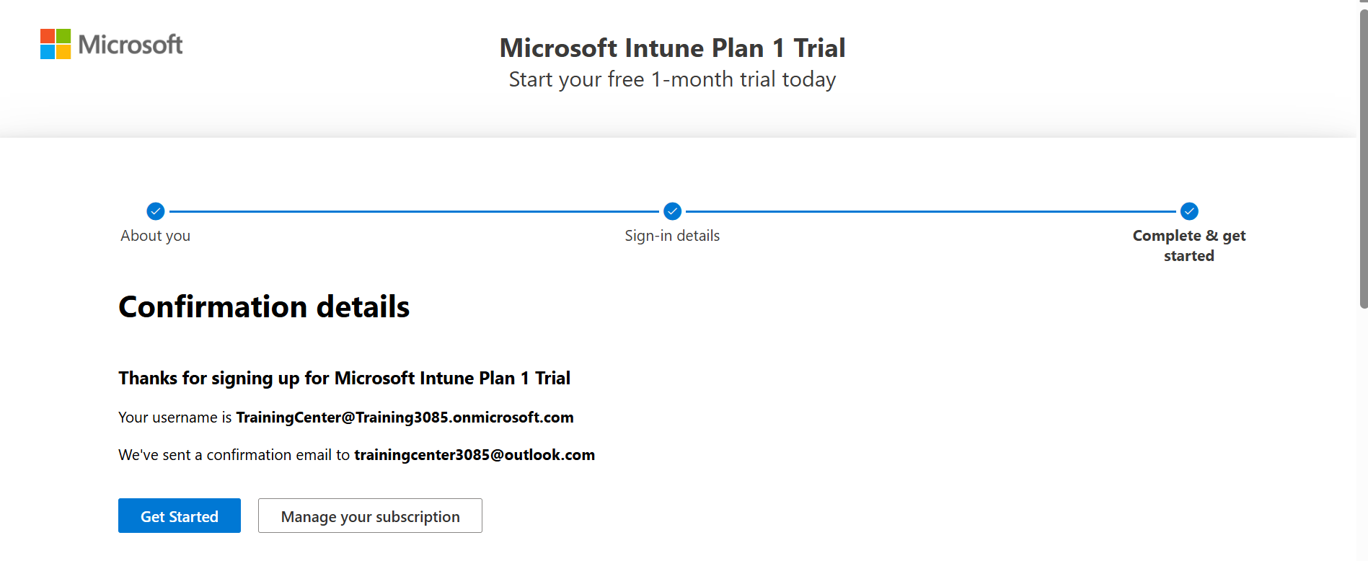
Microsoft Intune

Slide 50
Intune - Architecture & Deployment
Intune is fully cloud-based and does not require on-premises infrastructure. Deployment steps typically include:
Setting up tenant and roles in Microsoft Endpoint Manager admin center.
Defining compliance and configuration profiles.
Enrolling devices through automatic or manual methods.
Deploying apps and applying protection policies.
Monitoring via built-in dashboards and reporting tools.

Slide 51
Company Portal
Microsoft Intune Company Portal
The Company Portal is the end-user-facing app provided by Microsoft Intune. It allows users to enroll their devices, access corporate apps and resources, and view device compliance status.
It serves as the gateway for organizations to provide self-service capabilities while enforcing corporate policies.

Slide 52
Company Portal
How the Company Portal Works (Flow)
User installs the Company Portal from their app store.
Signs in with their work or school account.
Follows guided steps to enroll the device.
Device receives compliance policies, configuration profiles, and access to apps.
User can install apps, monitor device health, and manage settings through the portal.

Slide 53
Company Portal
Sync Company Portal
The initial sync refers to the process that occurs after a device is enrolled through the Company Portal app. This sync is critical—it establishes the connection between the enrolled device and Microsoft Intune, allowing the system to apply policies, install apps, and evaluate compliance.
Manual Sync (Post-Enrollment)
If apps or policies are missing, users can manually trigger a sync:
Windows:
  Go to Settings > Accounts > Access work or school
  Click the connected work account > Info > Sync
Company Portal App:
  Open the app > Tap on the device > Select “Check Status” or “Sync”

Slide 54
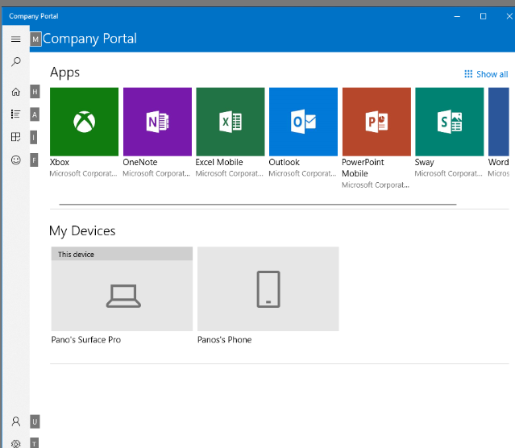
Company Portal

Slide 55
Intune Assignments
When you add an application to Microsoft Intune, you must assign it to users or devices. Intune provides three assignment intent options:
Required
Available for Enrolled Devices
Uninstall (used to remove apps)

Slide 56
Intune Assignments
Required App Assignment: The app is automatically installed on targeted user or device groups without user interaction.
Ideal for critical business apps that all employees or devices must have.
Key Characteristics:
Silent installation after the device is enrolled.
No user action required.
Retry logic is built in (if the install fails, Intune will retry).
Useful for both Win32 apps and LOB apps.
Example Use Cases:
Antivirus software or endpoint protection agents.
VPN or network security tools.
Microsoft Office Suite for all corporate laptops.

Slide 57
Intune Assignments
Available App Assignment: The app is optional, and users can install it themselves via the Company Portal app.
Best suited for non-essential apps or apps required by only some users.
Key Characteristics:
User-initiated installation.
Requires the device to be enrolled and have the Company Portal app installed.
No forced installation or silent deployment.
Suitable for BYOD or user-discretionary apps.
Example Use Cases:
Adobe Reader or Zoom for meetings.
Third Party Browers
Internal training apps or tools.

Slide 58
Intune Groups
There are two main types of groups:
Static Groups: Groups where members are manually added or removed by an administrator.
Dynamic Groups: Groups that automatically include users or devices based on defined rules (queries).
Types:
Dynamic User Group: Members are added based on user attributes (e.g., department, job title, location).
Dynamic Device Group: Members are added based on device attributes (e.g., OS type, device ownership, name pattern).

Slide 59
Intune – Windows Apps Packaging
"Microsoft Store app (new)" is the modern, recommended way to deploy Store apps using Intune’s integration with the Microsoft Store for Business powered by Winget (Windows Package Manager). It is designed for simplicity, automation, and better long-term support.
"Microsoft Store app (legacy)" refers to the older method that integrates with the Microsoft Store for Business or Education, where apps are added to your Store for Business tenant and synced into Intune.

Slide 60
Intune – Windows Apps Packaging
Microsoft 365 Apps for Windows 10 and later - To install your choice of Microsoft 365 Apps on managed devices running Windows 10 or later. Users must have an account and license to use these apps.
Microsoft Edge for Windows 10 and later – To install the Microsoft Edge browser on managed devices running Windows 10 or later.
Windows Web link: To add a Windows web link, copy and paste a website URL into App information. For Windows 10 and later devices, a shortcut to the website is added to the Start menu.

Slide 61
Intune – iOS Apps Packaging
iOS store app: The built-in iOS App Store to find free apps for iOS devices.
iOS/iPadOS web clip: To add an iOS/iPadOS web clip, copy and paste a website URL into App information. For iOS/iPadOS devices, a shortcut to the web clip is added to the Home screen.
Line-of-business app: To add a custom or in-house app, upload the app’s installation file. Make sure the file extension matches the app’s intended platform.
Intune supports the following line-of-business app platforms and extensions:
iOS (IPA)
macOS (.pkg)

Slide 62
Intune – macOS Apps Packaging
Line-of-business app: To add a custom or in-house app, upload the app’s installation file. Make sure the file extension matches the app’s intended platform.
Intune supports the following line-of-business app platforms and extensions:
iOS (IPA)
macOS (.pkg)
macOS app (DMG): To add a macOS application, upload the app’s installation file. Intune supports .dmg files containing .app files.
macOS apps are deployed using the Microsoft Intune management agent for macOS.
macOS app (PKG): To add a macOS application, upload the app’s installation file. Intune supports .pkg files..

Slide 63
Intune – Android Apps Packaging
Android store app: Go to Google Play Store to find apps for Android devices. To add an app, copy and paste its Google Play Store URL into App information.
Managed Google Play app: Search the built-in managed Google Play store to find and add apps for Android Enterprise devices.
Line-of-business app: To add a custom or in-house app, upload the app’s installation file. Make sure the file extension matches the app’s intended platform. Intune supports the following line-of-business app platforms and extensions:
Android (APK)
Android Enterprise system app: Add an Android Enterprise system app to your dedicated or fully managed Android Enterprise devices. Contact the device manufacturer to get the app's package name.

Slide 64
Intune – LOB VS Win32
Line-of-Business (LOB) Apps are custom-built applications developed internally for an organization. Typically packaged in standard formats like .msi, .appx, .apk, .ipa, etc., depending on the platform.
Uploaded and deployed through Intune for specific use cases (e.g., internal business operations).
Win32 Apps are traditional desktop applications built for Windows, typically with a .exe, .msi, or complex installer.
Managed using Intune Win32 App Management, which packages the app into .intunewin format via the Microsoft Win32 Content Prep Tool.
Offers advanced control over installation, detection, and requirements.

Slide 65
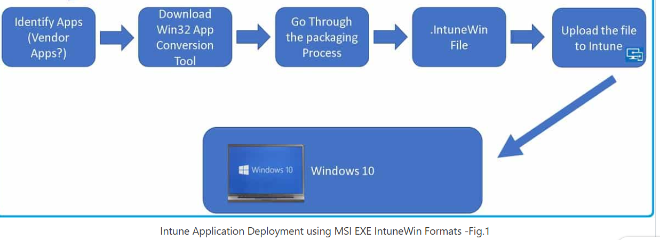
IntuneWin Conversion Flow

Slide 66
Application Deployment - Workflow
Application Deployment WorkFlow via Intune – Log locations

